Slide 1
Online Payments Fraud Detection Using Machine Learning

Slide 2
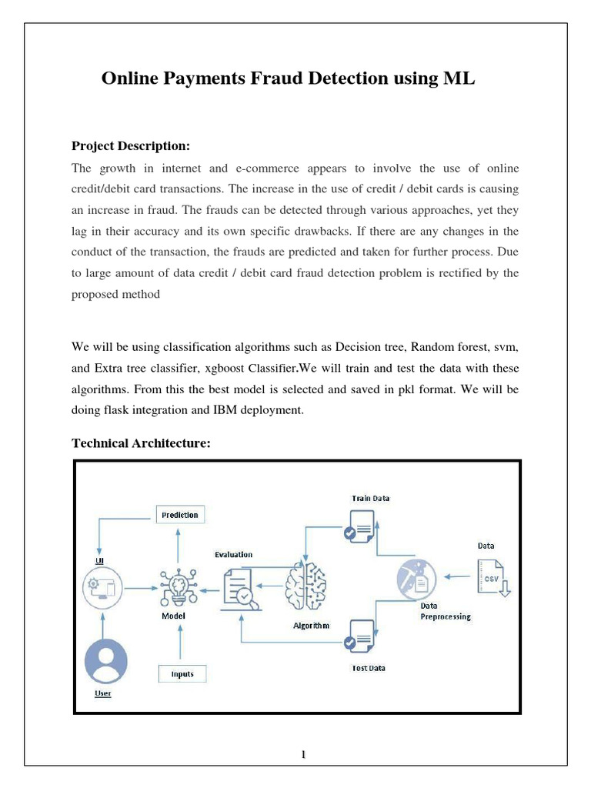
Introduction to Online Payments Fraud Detection
Online payments fraud is a significant challenge for financial institutions and e-commerce platforms.
Machine learning offers advanced techniques to identify and prevent fraudulent transactions effectively.
This presentation explores how machine learning models are developed and applied to detect fraud in real-time.
1
Notes:
Image source: https://imgv2-1-f.scribdassets.com

Slide 3

Types of Online Payments Fraud
Card-not-present fraud involves unauthorized use of card details for online transactions.
Account takeover occurs when fraudsters gain control over user accounts to make illicit purchases.
Synthetic identity fraud combines real and fake information to create new, fraudulent identities.
2
Notes:
Image source: https://phdprojects.org

Slide 4
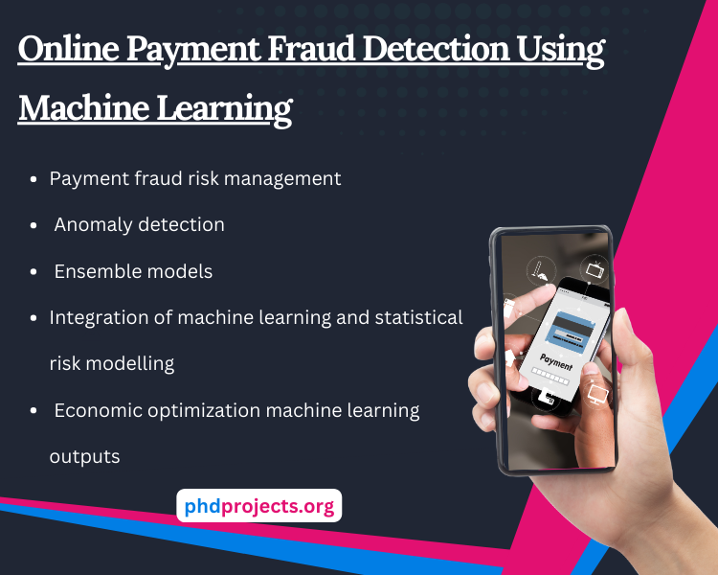
Challenges in Fraud Detection
Fraudulent transactions are constantly evolving, making detection a moving target.
Imbalanced datasets with few fraud cases compared to legitimate ones complicate model training.
Ensuring real-time detection without impacting user experience is a critical requirement.
3
Notes:
Image source: https://phdprojects.org

Slide 5
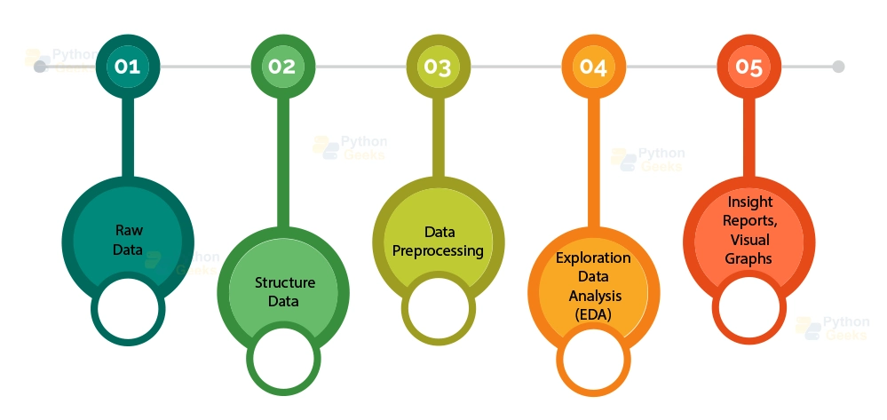
Data Collection and Preprocessing
Data sources include transaction records, user behavior, device information, and historical fraud labels.
Data cleaning involves handling missing values, outliers, and inconsistent entries.
Feature engineering transforms raw data into meaningful features to improve model performance.
4
Notes:
Image source: https://pythongeeks.org

Slide 6
Machine Learning Algorithms for Fraud Detection
Supervised learning algorithms like Random Forests and Gradient Boosting are commonly used.
Unsupervised methods such as clustering help identify anomalies without labeled data.
Deep learning models like neural networks capture complex patterns in large datasets.
5
Notes:
Image source: https://phdprojects.org

Slide 7
Model Training and Evaluation
Models are trained on labeled datasets with known fraudulent and legitimate transactions.
Evaluation metrics include precision, recall, F1-score, and ROC-AUC to assess performance.
Cross-validation and backtesting ensure the model generalizes well to unseen data.
6
Notes:
Image source: https://opengraph.githubassets.com

Slide 8
Deployment and Real-Time Detection
Models are integrated into payment processing systems for instant fraud scoring.
Threshold tuning balances fraud detection rate and false positive rate to optimize user experience.
Continuous monitoring and model updating adapt to evolving fraud tactics.
7
Notes:
Image source: https://phdprojects.org

Slide 9
Challenges and Ethical Considerations
Data privacy and security must be maintained when handling sensitive transaction data.
Bias in training data can lead to unfair treatment of certain user groups.
Transparency and explainability of models are essential for compliance and user trust.
8
Notes:
Image source: https://opengraph.githubassets.com

Slide 10
Future Trends in Fraud Detection
Incorporation of adaptive learning techniques to respond to new fraud patterns dynamically.
Use of advanced AI methods like reinforcement learning for proactive fraud prevention.
Collaboration among financial institutions to share threat intelligence and improve detection accuracy.
9
Notes:
Image source: https://phdprojects.org

Slide 11
Conclusion
Machine learning significantly enhances the ability to detect and prevent online payment fraud.
Ongoing research and technological advancements are vital to stay ahead of fraudsters.
Implementing robust, ethical, and adaptive fraud detection systems is critical for secure digital transactions.
10
Notes:
Image source: https://opengraph.githubassets.com

